Slide 1

Counterfactual Fairness Matt Kurner, Joshua Loftus, Chris Russell, Ricardo Silva
Seminar in Advanced Topics in Machine Learning and Data Science
by Prof. Fernando Perez-Cruz
Presented by Sven Gregorio
2 June 2021

Slide 2
Table of Contents
Introduction and Problem Statement
Background: Desirability of fairness in ML
Problem: Trained ML can be biased and older solutions inadequate
Main Contribution: A better approach to fairness
Technical contribution
Counterfactual fairness: definition of fairness based on causal models
FairLearning: algorithm guaranteed to be counterfactually fair
Experiments
Law school success prediction
NYC Stop-and-Frisk
My take
Strengths and Weaknesses
Takeaways

Slide 3
Introduction and Problem Statement

Slide 4
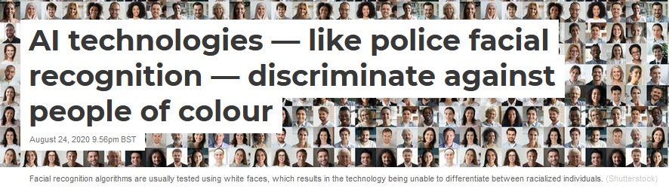
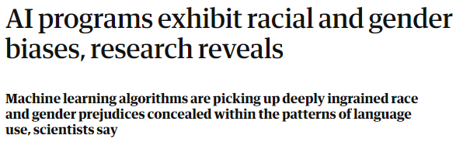
Background: Bias and discrimination
In some settings current ML approaches can worsen discrimination
Datasets may contain bias
Historical discrimination can be correlated with optimization objective
Sources:
1: https://theconversation.com/ai-technologies-like-police-facial-recognition-discriminate-against-people-of-colour-143227
2: https://www.theguardian.com/technology/2017/apr/13/ai-programs-exhibit-racist-and-sexist-biases-research-reveals
Notes:
We all know fairness in

Slide 5
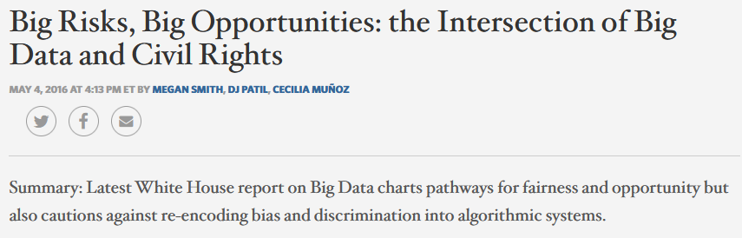
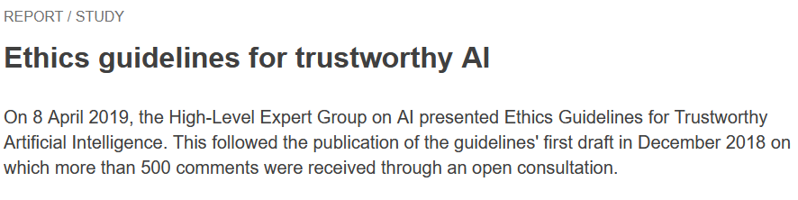
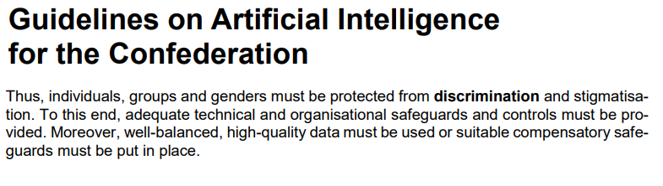
Background: Fairness in Machine Learning
Sources:
-USA: https://obamawhitehouse.archives.gov/blog/2016/05/04/big-risks-big-opportunities-intersection-big-data-and-civil-rights
-EU: https://digital-strategy.ec.europa.eu/en/library/ethics-guidelines-trustworthy-ai
-CH: https://www.sbfi.admin.ch/dam/sbfi/en/dokumente/2021/05/leitlinien-ki.pdf.download.pdf/leitlinien-ki_e.pdf

Slide 6
Motivational Problem: Law School Success Prediction
Data:
Survey across 163 law schools in 1998.
Data about 21,790 individuals:
GPA: Grade-Point Average
LSAT: Entrance exam score
FYA: First Year Average
Task:
Predict FYA of candidate student.
Avoid discriminating against protected attributes.
Sex | Race | GPA | LSAT | FYA
Male | White | - | + | +
Female | Black | + | + | -
Male | Black | + | - | -
A: Protected
X: Observable
Y: Outcome

Slide 7
Fairness by Unawareness
Sex | Race | GPA | LSAT | FYA
 |  | - | + | +
 |  | + | + | -
 |  | + | - | -
Sex | Race | GPA | LSAT | FYA
Male | White | - | + | +
Female | Black | + | + | -
Male | Black | + | - | -
Definition:
An algorithm is fair so long as any protected attributes A are not explicitly used in the decision-making process.
Can be unfair, since observable attributes can be correlated with the protected attributes:
GPA may be affected by a teacher’s perception of gender.
Students of a particular race may underperform in LSAT because they feel unsupported.

Slide 8
Main Contributions
Definition of Counterfactual Fairness
Intuition: No protected attribute should influence the prediction of the algorithm.
Introduction of the FairLearning algorithm
The algorithm is provably counterfactually fair.
Intuition:
Use model to infer latent attributes.
Use model to isolate influence of protected attributes.
The algorithm only uses non-protected information.

Slide 9
Technical Contribution

Slide 10
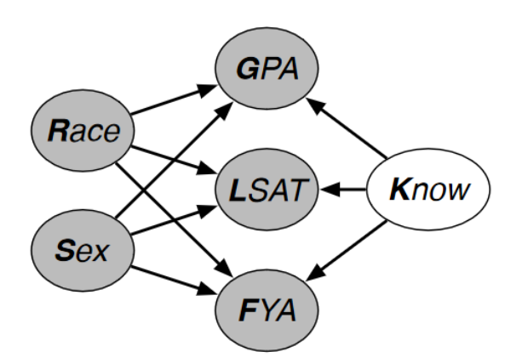
Model Notation
Model M of the causal relations of our world
Set A of protected attributes
In our example, A = {Sex, Race}
Set X of observable attributes
In our example X = {GPA, LSAT}
Set U of unobservable attributes
In our example we may have U = {Knowledge}
Y is the outcome to predict
In our example Y = FYA
X
A
U
Y

Slide 11
Towards Counterfactual Fairness: What is Fair?
An algorithm is fair when its predictions are free of any bias towards protected attributes.
Hard to achieve in practice: the available data may be biased.
Using biased historical data can enable discrimination.
Ideally we could compare two individuals fairly if we could compare one individual against a version of the other with the same protected attributes.
E.g. Compare the grades of students A and B by setting B’s race and sex to A’s.
Hard to accomplish: we need to model how the protected attributes influence the other.

Slide 12
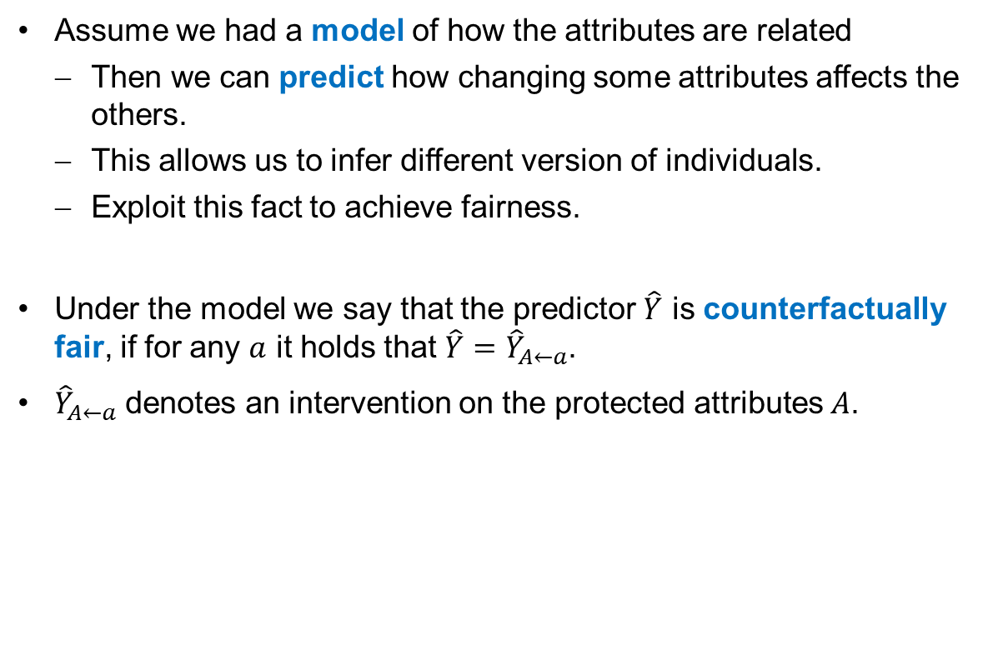
Modelling the Causal Relations of the Data
Assume we had a model of how the attributes are related
Then we can predict how changing some attributes affects the others.
This allows us to infer different version of individuals.
Exploit this fact to achieve fairness.
Under the model we say that the predictor $\hat{Y}$ is counterfactually fair, if for any $a$ it holds that $\hat{Y}=$ ${\hat{Y}}_{A←a}$.
${\hat{Y}}_{A←a}$ denotes an intervention on the protected attributes $A$.

Slide 13
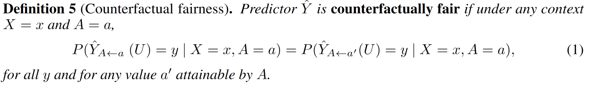
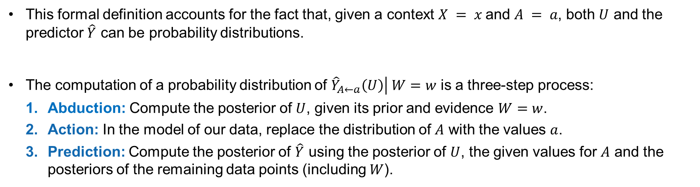
A Formal Definition of Counterfactual Fairness
This formal definition accounts for the fact that, given a context $X = x$and $A = a$, both $U$ and the predictor $\hat{Y}$ can be probability distributions.
The computation of a probability distribution of $\left.{\hat{Y}}_{A←a}\left(U\right)\right| W=w$ is a three-step process:
Abduction: Compute the posterior of $U$, given its prior and evidence $W=w$.
Action: In the model of our data, replace the distribution of $A$ with the values $a$.
Prediction: Compute the posterior of $\hat{Y}$ using the posterior of $U$, the given values for $A$ and the posteriors of the remaining data points (including $W$).

Slide 14
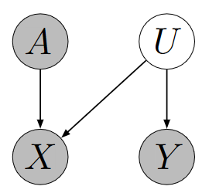
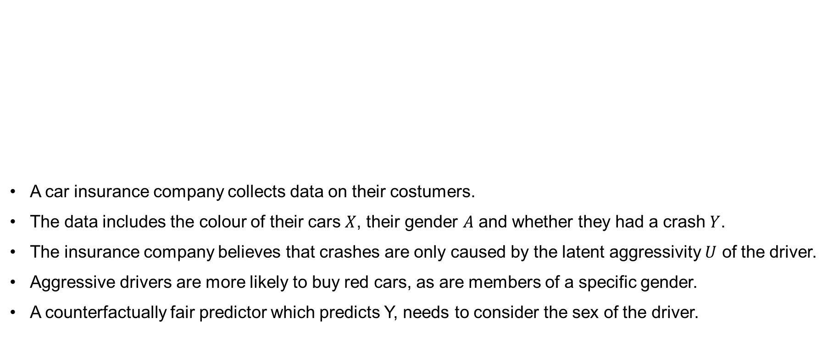
Hypothetical Scenario: The Red Car
A car insurance company collects data on their costumers.
The data includes the colour of their cars $X$, their gender $A$ and whether they had a crash $Y$.
The insurance company believes that crashes are only caused by the latent aggressivity $U$ of the driver.
Aggressive drivers are more likely to buy red cars, as are members of a specific gender.
A counterfactually fair predictor which predicts Y, needs to consider the sex of the driver.

Slide 15
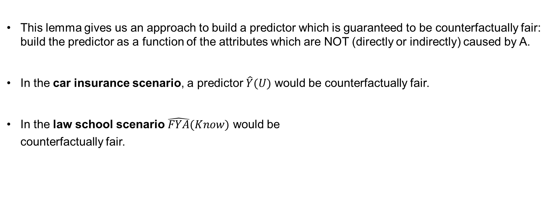
Counterfactual Fairness in Practice
This lemma gives us an approach to build a predictor which is guaranteed to be counterfactually fair: build the predictor as a function of the attributes which are NOT (directly or indirectly) caused by A.
In the car insurance scenario, a predictor $\hat{Y}(U)$ would be counterfactually fair.
In the law school scenario $\hat{FYA}(Know)$ would be
counterfactually fair.

Slide 16
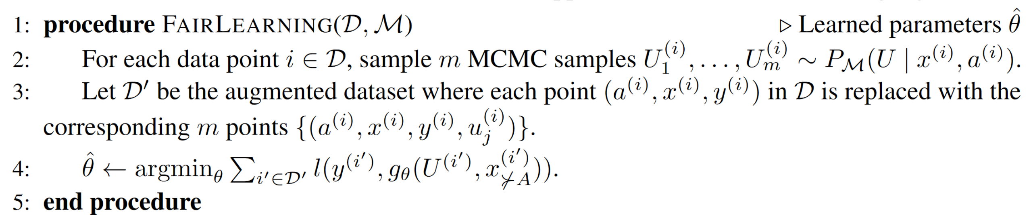
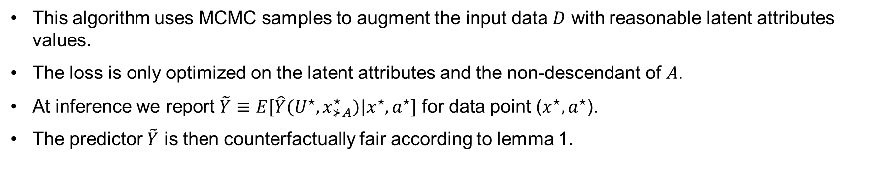
An Algorithm for Counterfactual Fairness
This algorithm uses MCMC samples to augment the input data $D$ with reasonable latent attributes values.
The loss is only optimized on the latent attributes and the non-descendant of $A$.
At inference we report $\tilde{Y}≡E[\hat{Y}(U^{⋆}, x_{⊁A}^{⋆})|x^{⋆}, a^{⋆}]$ for data point ($x^{⋆}, a^{⋆}$).
The predictor $\tilde{Y}$ is then counterfactually fair according to lemma 1.

Slide 17
Experiments

Slide 18
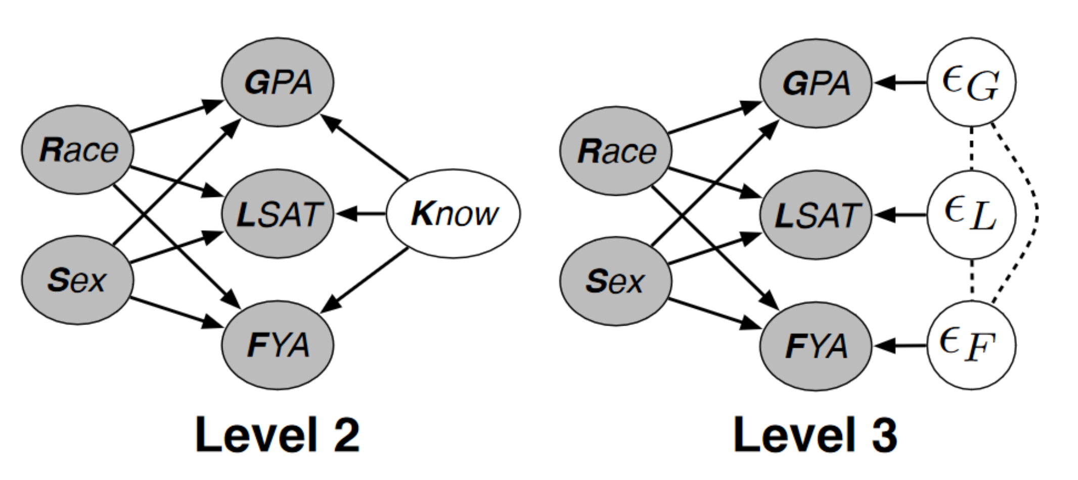
Return to the Law School Success Prediction
Consider following logistic regression predictors:
Full: uses all observable attributes (even protected ones).
Unaware: uses only non protected variables.
Fair K: The attributes are modelled according the formulas:
Fair Add: Use the empirical distribution of residuals.
Fair K
Fair Add

Slide 19
Evaluation of the Accuracy
Evaluating the model on a real dataset with the data of 21790 law students gives the following RMSE:
The fair predictors are less accurate than the unfair ones.
The error of the fair predictors is still close to the unfair models.
The results show a small price for fairness.
Model | RMSE
Full | 0.873
Unaware | 0.894
Fair K | 0.929
Fair Add | 0.918

Slide 20
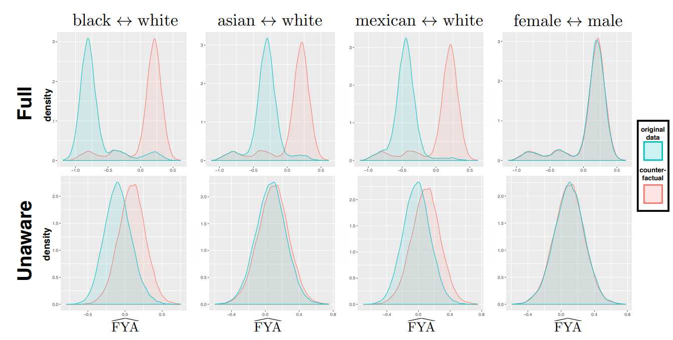
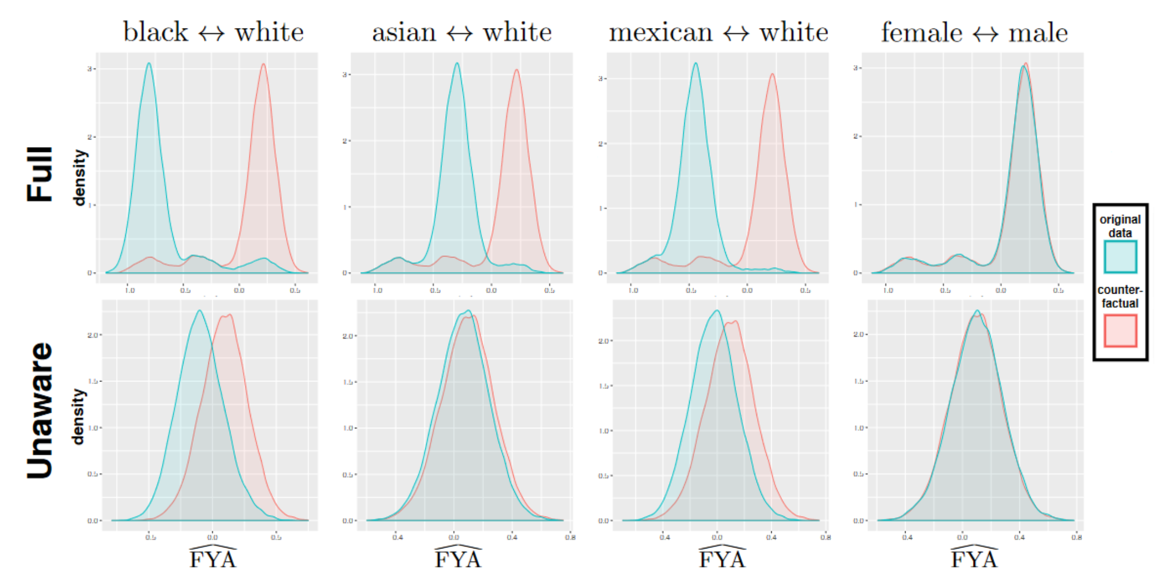
Testing the Fairness of the Unfair Predictors
Assume that the model used by Fair K accurately describes reality.
We can then plot how the prediction of the unfair predictor change with counterfactuals:

Slide 21
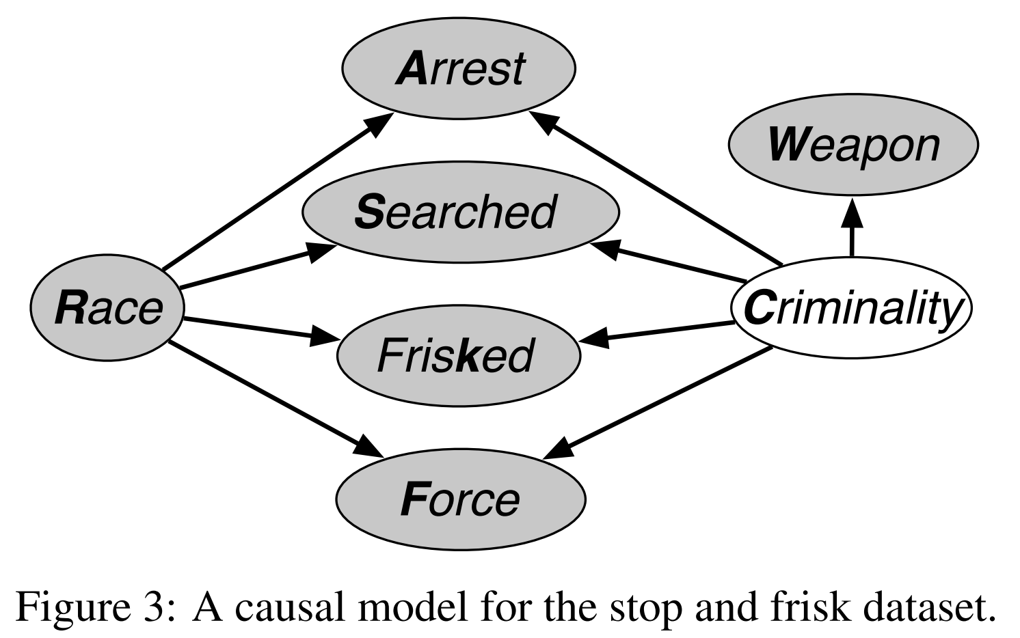
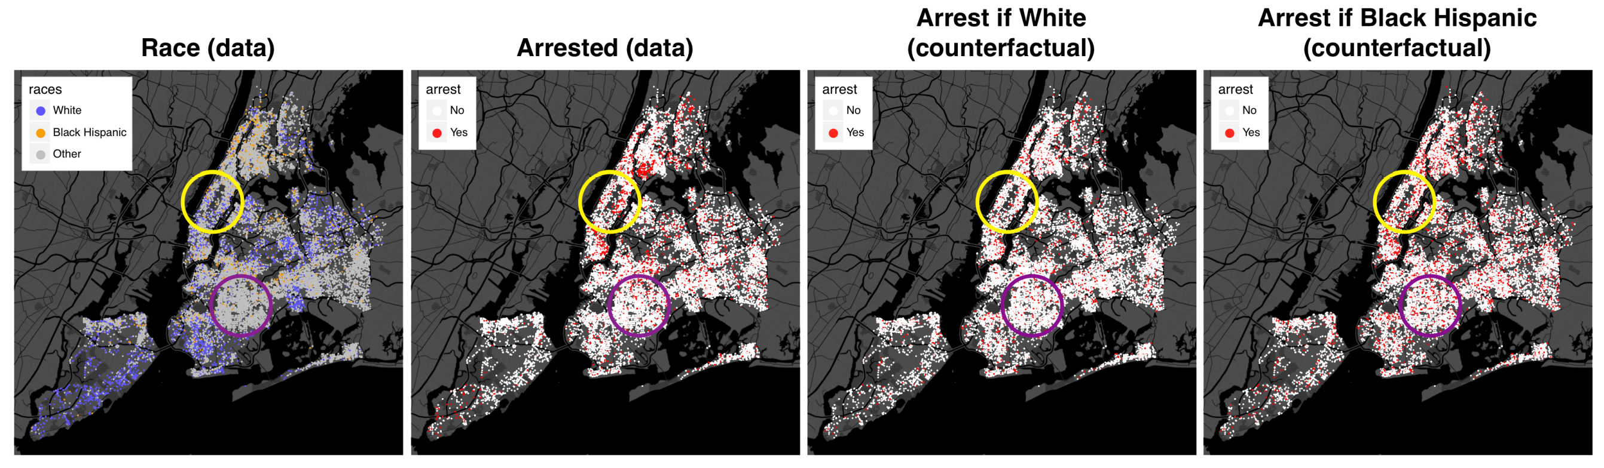
NYC Stop-and-Frisk Data
This experiment uses the data collected by the New York Police Department about every time a police officer stopped someone in 2014.
Consider the model given by the graph:
According to this model:
If every stopped individual had been White,
there would have been 34% less arrests.
If every stopped individual had been Black Hispanic,
there would have been 13% more arrests.

Slide 22
My Take

Slide 23
Strengths
Well written paper which presents its contribution and ideas clearly.
The authors clearly show that the collection of sensitive data is necessary to minimize discrimination.
The definition of counterfactual fairness captures a good intuition of fairness.
The paper presents a provably counterfactually fair algorithm.
The definition of counterfactual fairness allows evaluating the fairness of existing algorithms.
The definition of counterfactual fairness can be adapted to a differentiable stochastic measure of fairness.
The measure can be used as a regularizer.
This allows balancing raw accuracy with fairness according to the user’s need.

Slide 24
Weaknesses
The first examples are only discussed after all the definition of fairness are introduced.
The given results are only for a linear ML model.
The requirement of having a model of the real world can be problematic:
Finding a good model, or detecting a bad one, can be difficult.
Using a wrong model can lead to the illusion of having a fair algorithm.
Incorrectly believing that an algorithm is fair can enable discrimination.
The FairLearning algorithm can possibly discard useful data.

Slide 25
Takeaways
The paper challenges the reader to reconsider what he considers fair.
A new definition of fairness is given and explained with good intuitions.
It is shown how one can build a fair algorithm.
Collecting sensitive data is necessary to be fair.
A good model of the world may be necessary to build fair algorithms.

Slide 26
End of the presentation

